Slide 1
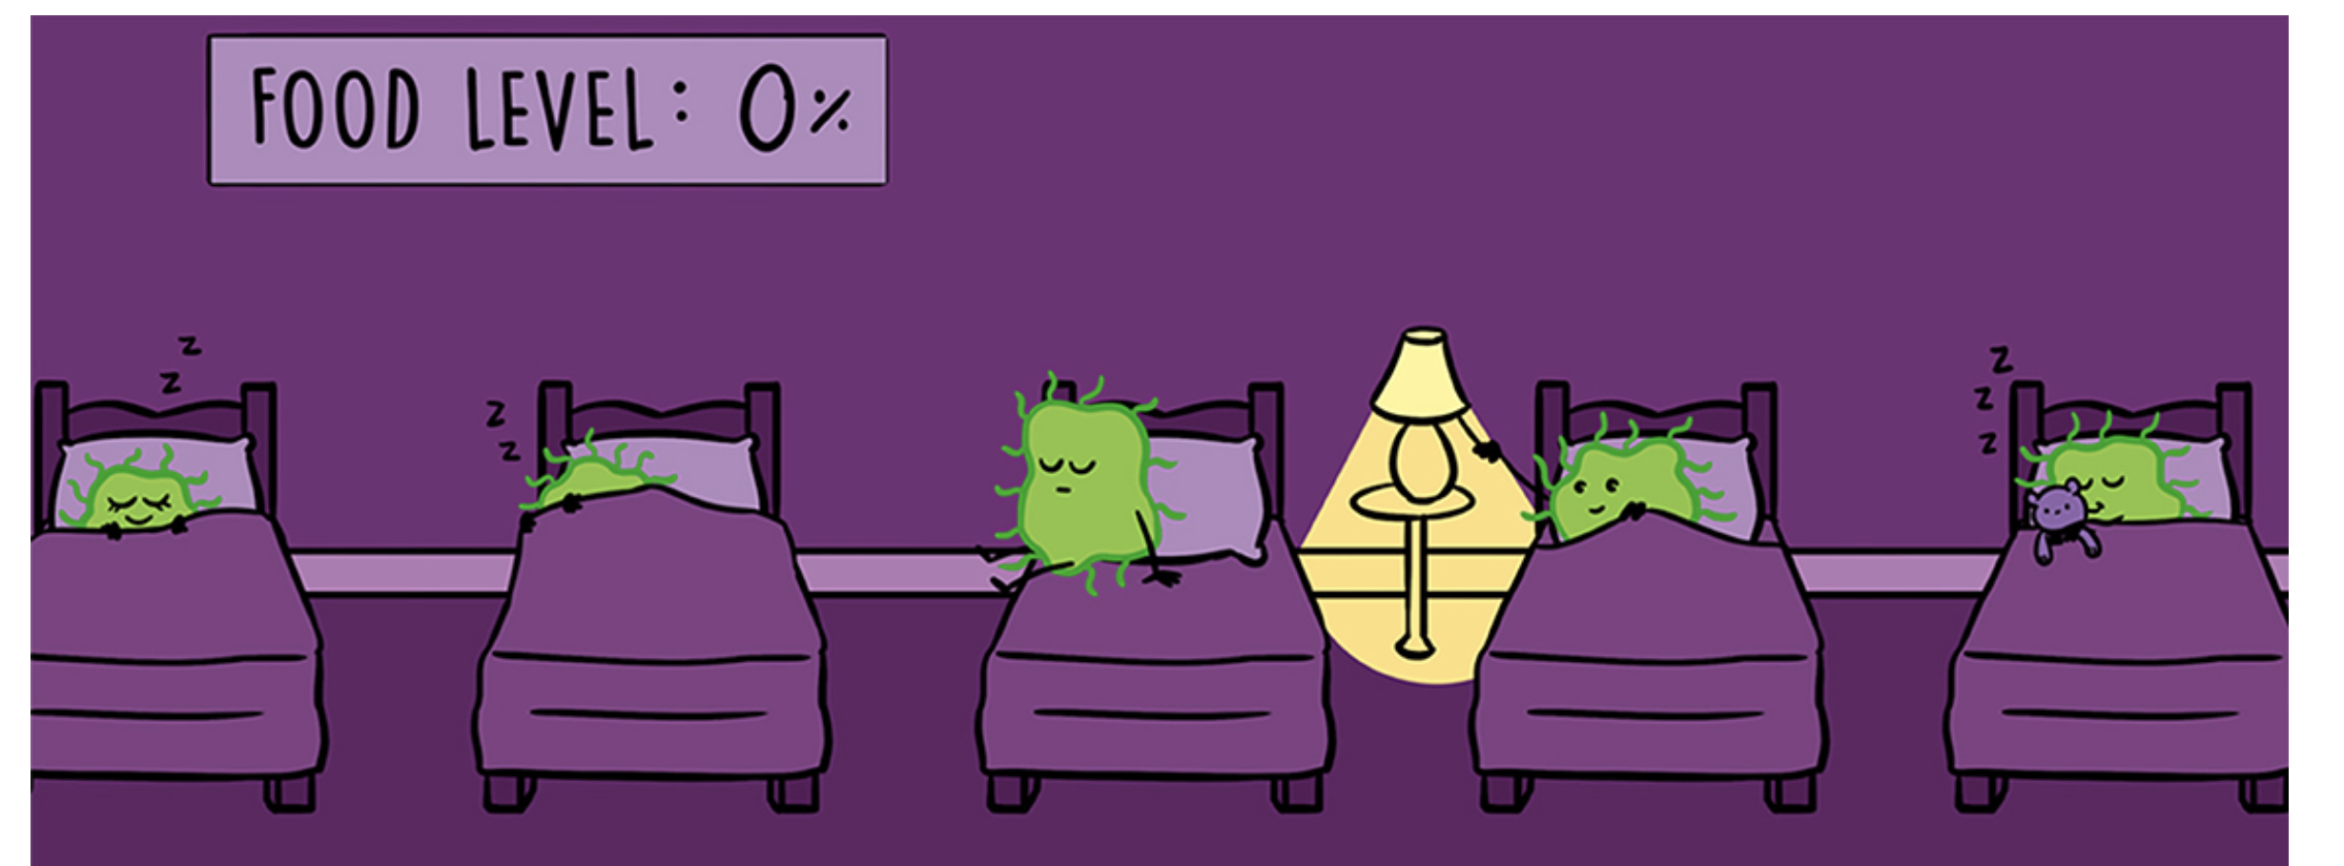
PDE models of plaque growth + Image analysis updates
Bee update Wed, May 24th
Andreea Magalie

Slide 2
GFP analysis

Slide 4
GFP analysis
Extract Green component
Blur image with a circular filter
Find center of plaque as the intersection of plaque diameters, i.e. minimum row and col with GFP signal
Plot GFP based on distance from center

Slide 5
GFP analysis
Extract Green component
Blur image with a circular filter
Find center of plaque as the intersection of plaque diameters, i.e. minimum row and col with GFP signal
Plot GFP based on distance from center

